Slide 1
How to access Reading Book
Bayview Elementary

Slide 2
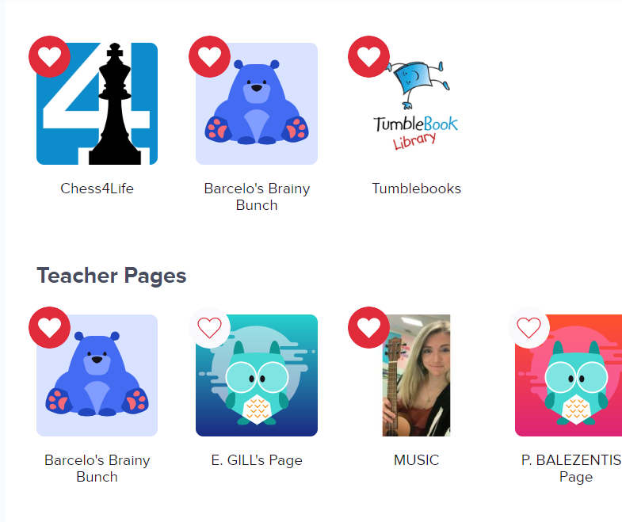
Clever Dashboard
Click on “Barcelo’s Brainy Bunch

Slide 3
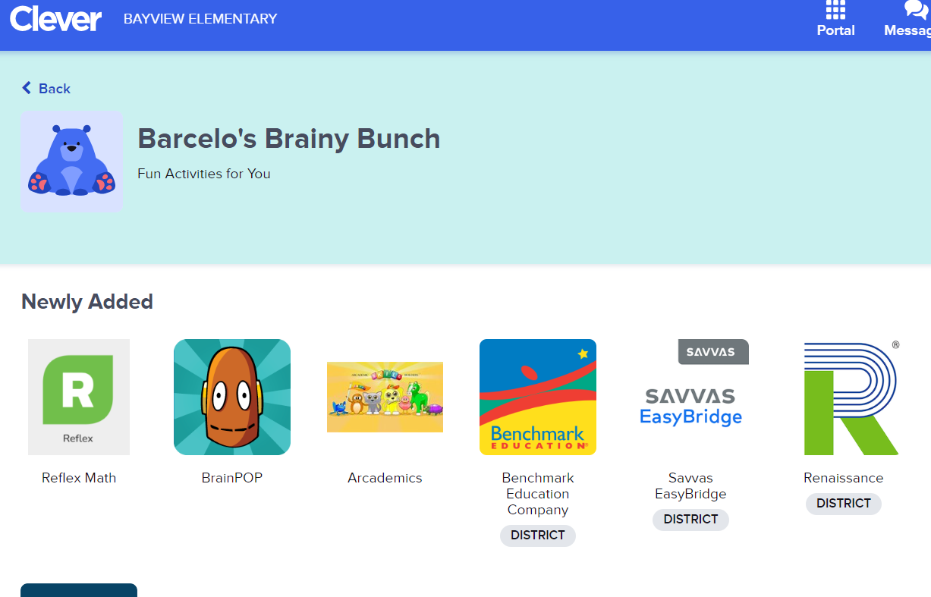
Class Page
Click on Benchmark Education Company

Slide 4
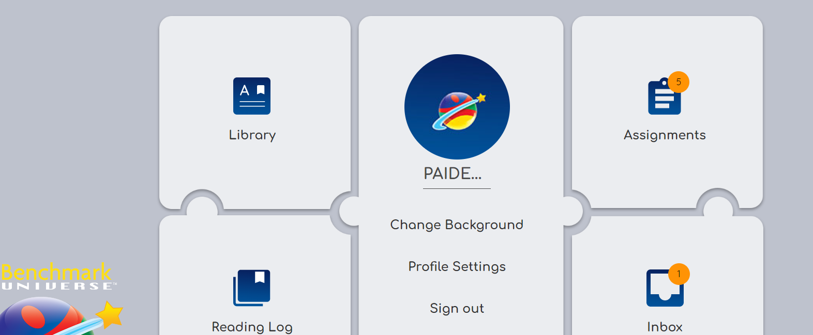
Click on “Assignments

Slide 5
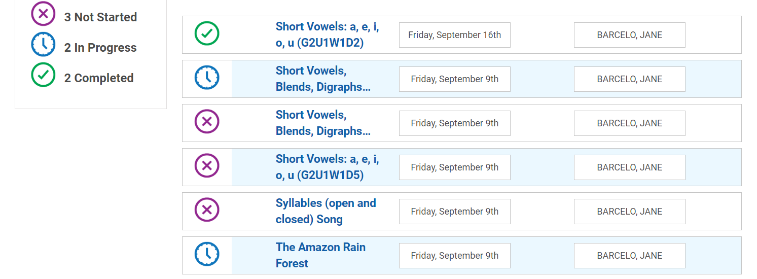
Click on “The Amazon Rain Forest”

Slide 6
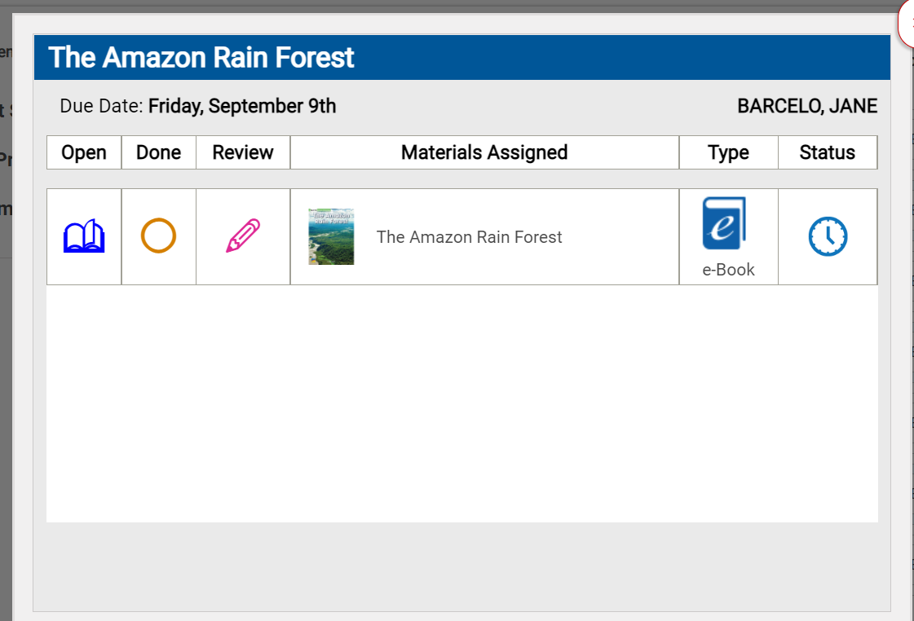
To Open the book, click on “open” icon

Slide 7
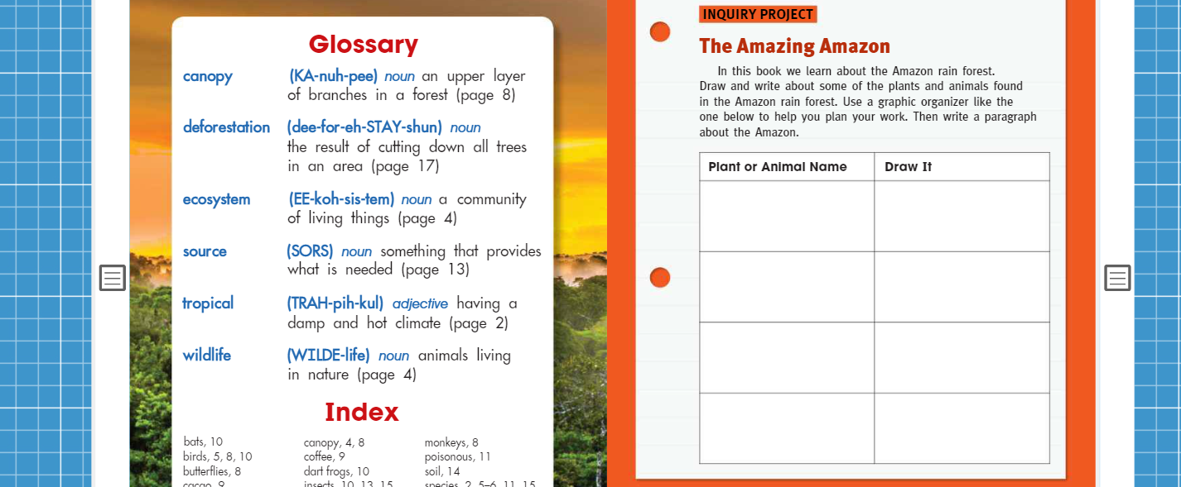
Tonight’s Assignment: Please complete on the paper in the “Sailboat” folder. Your child did the first one in class.
Complete on paper, not on the computer

